Slide 1

Electronic Health Record (EHR): Who uses it?
Notes:
Electronic Health Record, simply put, is a digital version of patient’s paper chart. EHRs are real-time records that make information, such as patient’s medical history, diagnoses, medications, etc, available instantly to authorized medical providers. It helps with more efficient workflow and communication among medical care providers and thus, helps to make well-informed decisions about a patient’s care in timely manner.

Slide 3
EHR use in the U.S.
State-level EHR use graph

Slide 4
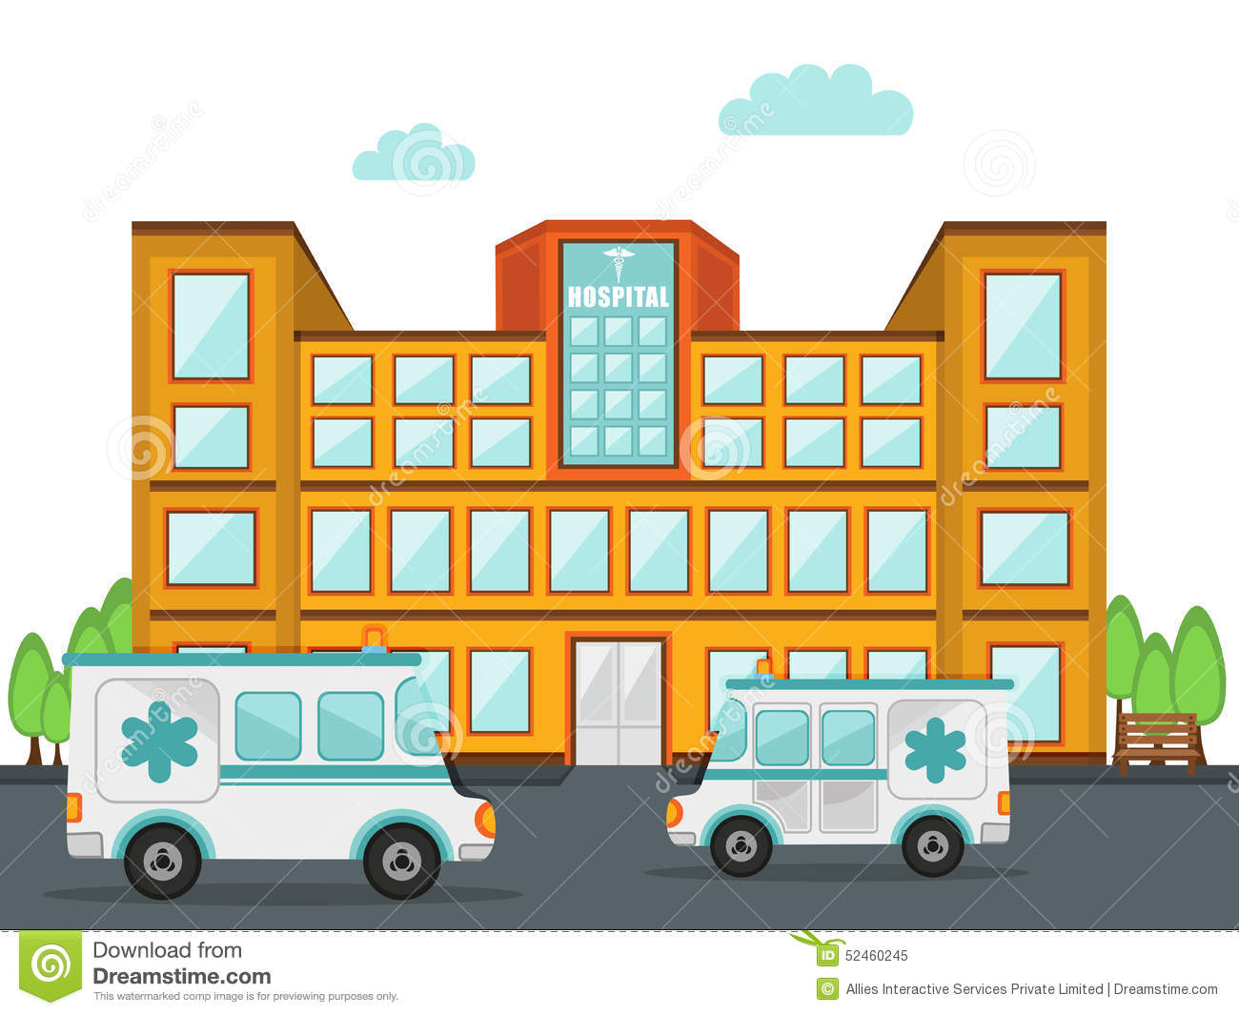
Notes:
[ %] of medical practitioners in the U.S. are employed by hospitals. [% ] are eligible professional who work individually. We investigated characteristics of hospitals that is associated with higher use of EHR, and characteristics of the medical practitioners that are associated with higher use of HER.

Slide 5
EHR use in US Hospitals
As of 2017, []% of U.S. Hospitals have adopted Electronic health Records

